Slide 1


TABEBK
Prepare by :
Khalid , Yahea , Safa , Anas
Supervised by :
Dr. Sari Awwad

Slide 2
Contents of this template
01
What is TABEBK program
02
03
04
What is distinctive about TABEBK program
Why was the goal to develop TABEBK program
The possibilities it
offers TABEBK
program

Slide 3
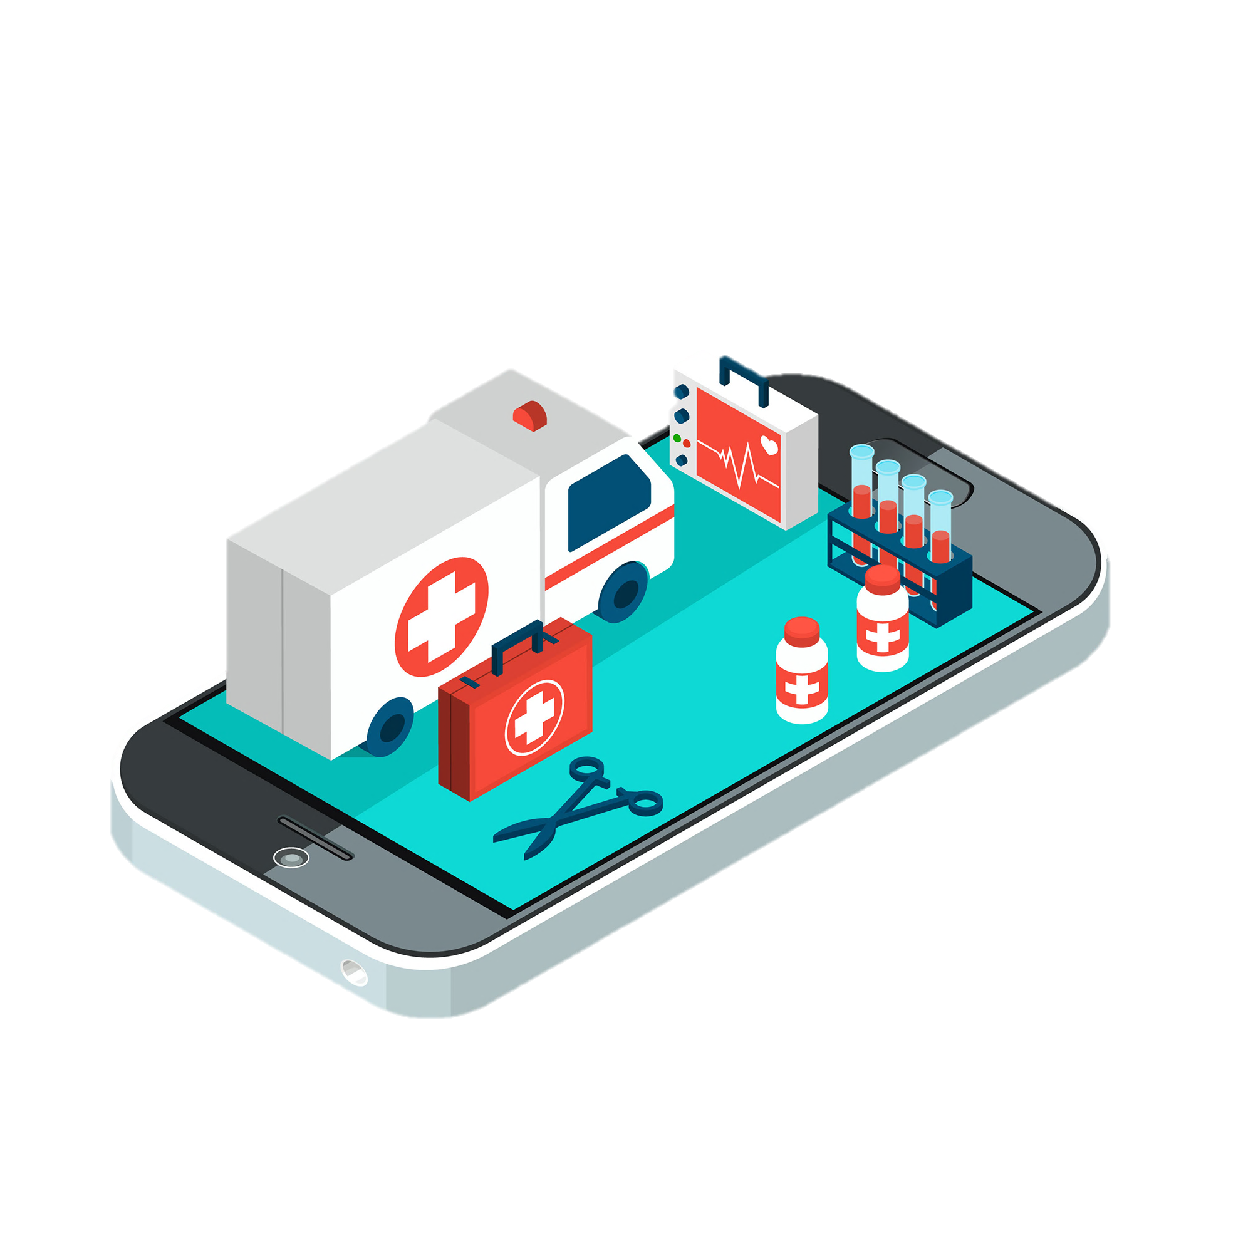
TABEBK!
A program dedicated to providing complete health care

Slide 4
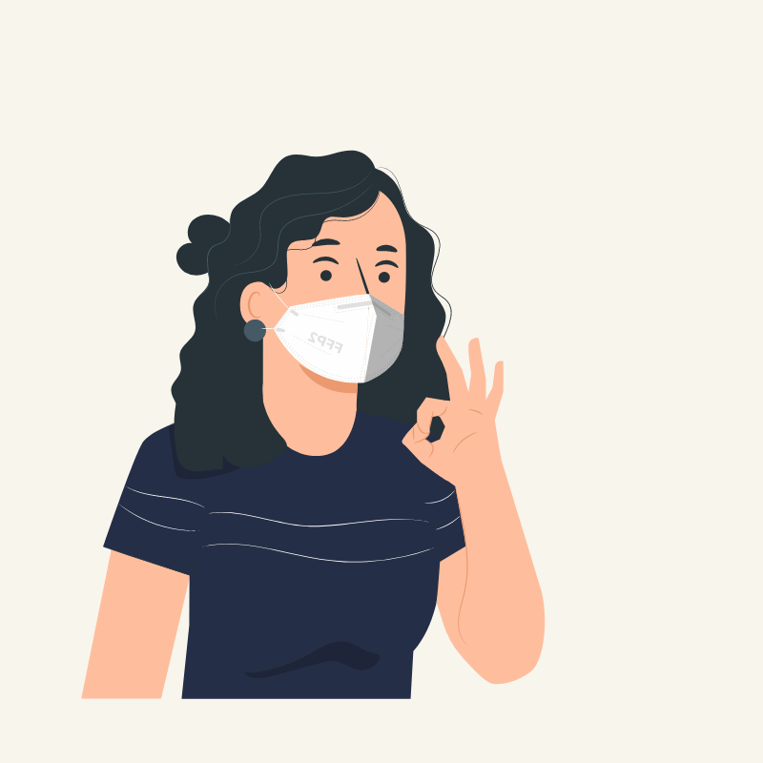
01
Healthcare
We have searched for the best health service that can be provided to you

Slide 5

Introduction
TABEBK can collect all the doctors in one program and see articles that may be related to the matter that you are interested in. He also reminds you of the date of your visits to the hospital, as well as your medications

Slide 6

the special idea
You can call an ambulance to your home with one click of a button without the need to contact the emergency

Slide 7

Appointments
We can inform you of your registered appointments as well as book appointments and see the places that suit you or which hospital is best for you at home without the need to go to the hospital and also remind you of your treatment appointment and see health news

Slide 8
We were able to save your time and effort

Slide 9

—Steve Jobs
" My favorite things in life don't cost any money. It's really clear that the most precious resource we all have is time"

Slide 10

Distinctive in TABEBK
02

Slide 11

Emergency
How many people had an emergency matter happened to him and could not explain where he was in for the ambulance
This feature of our project where you can request an ambulance without the need to communicate even with them through the application (it is also possible that you have an injury that prevents you from speaking) or when a certain thing occurs, you cannot speak or in difficult cases you may collapse in tears This causes an obstacle to the ambulance

Slide 12


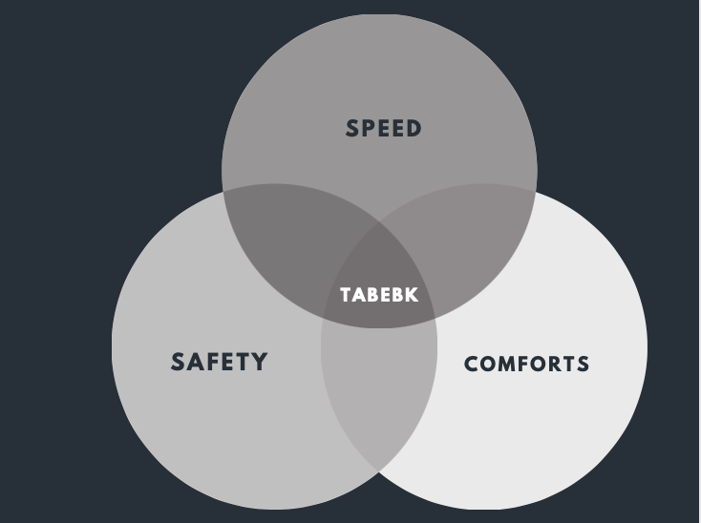
Compared
 | KAUH | Hakeem | TEBCAN | TABEBK
must be logged in to access services
What do we distinctive?
Recording appointments for medical reviews in the hospital
Availability in all governorates
Most of the medical services are available
Emergency request

Slide 13

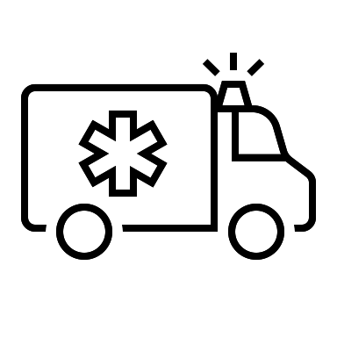
Method of work
Step 4
Determine whether you can make a call or there are notes that you want to add about your case
Minutes, the ambulance will be there
Step 2
Emergency request
Step 1
Step 3
detect location
Log in to the site with the national number

Slide 14
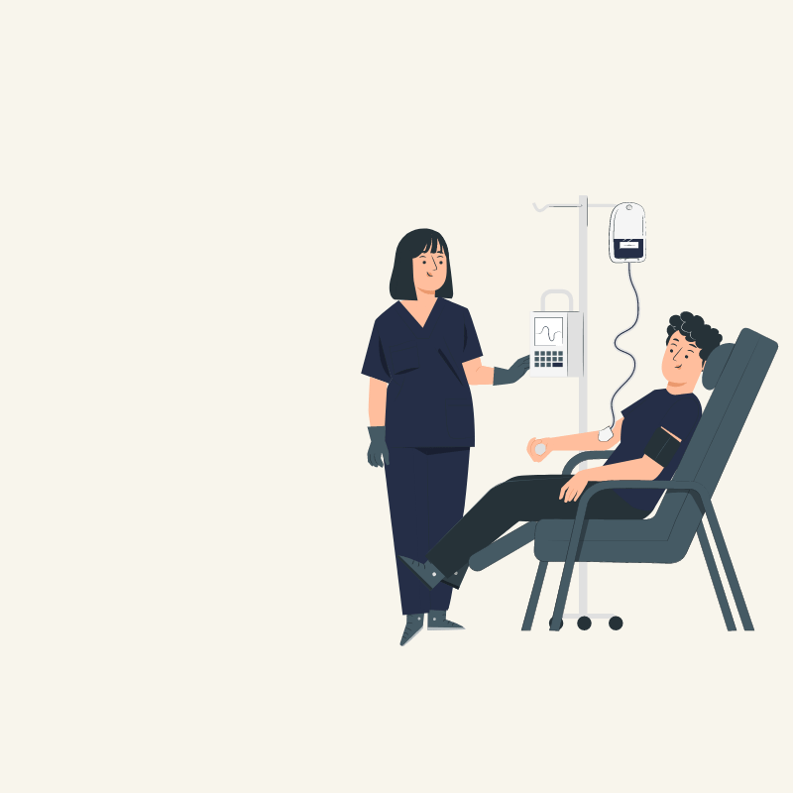

Goal to develop TABEBK program
03
Comforts
Reminder
Do a lot of medical procedures at home
Send you notifications to remind you of your appointments and medications
Discover
Educate
Determine which hospital carries out your needs
See all medical articles

Slide 15
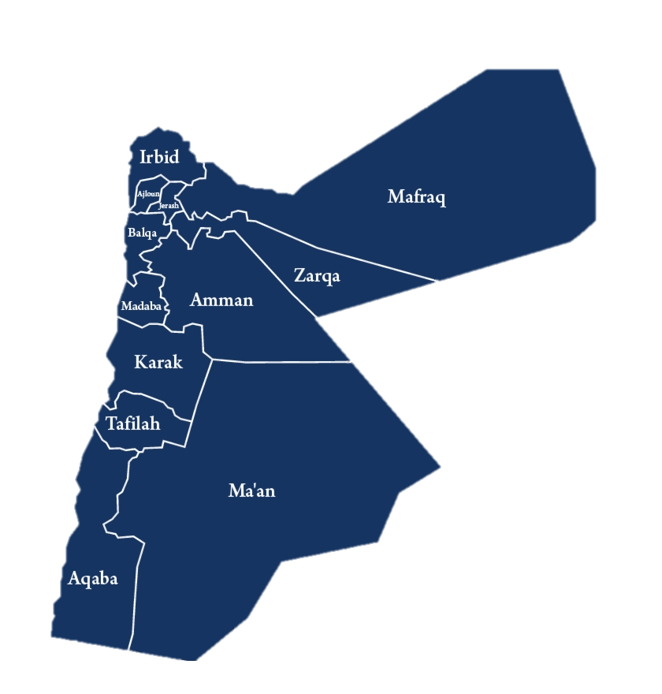
Cover
We seek to include all areas that the GPS program can identify and contribute to solving all problems so that it is available to all Jordanians
Jordan
Covering all governorates

Slide 16
Our process
01
Appointment
Remind
02
Book an appointment electronically
Send a message confirming the review appointment and a reminder before the specified time
04
Health
Prescription
03
Reminding you of medication appointments and staying in touch with you
Get the required medication and send it to your page

Slide 17
10,000,000
Facilitating medical life for all Jordanians

Slide 18
possibilities it offers TABEBK program
04
In summary, the application provides several privileges that are not available in other applications, so it is a complete hospital inside the home and all the available processes in the application have been considered, so it gives the rights of legal issues when tampering and provides direct communication with emergencies with several options, scheduling appointments, reminders about them, seeing prescriptions, or even medical reports approved without review the hospital

Slide 19
Protection
All data stored in the Ministry of Interior are linked to the database, and then the validity of the national number or even the identification number of the person who lives in Jordan is verified and the password is the same number

Slide 20
Emergency
When calling for an emergency, you have during the usual time period, the old traditional customs, such as calling the civil defense, describing your location, and then communicating to meet

Slide 21
Recipes and reports
Who among us could not read the prescription or not bring it with him or even forget it today, you can get your prescription electronically on a phone and also you can ask the doctor to send a medical report, for example, for a sick leave through the phone and attach it to the application and approve it without consulting the hospital

Slide 22
Determine the best location
You can specify to search for a hospital that provides a magnetic imaging service, etc., or even a specific device, or what is the nearest hospital to my site that has this device, or any hospital that deals with the health insurance that I carry, or search for a specific doctor in any hospital that does the work

Slide 23
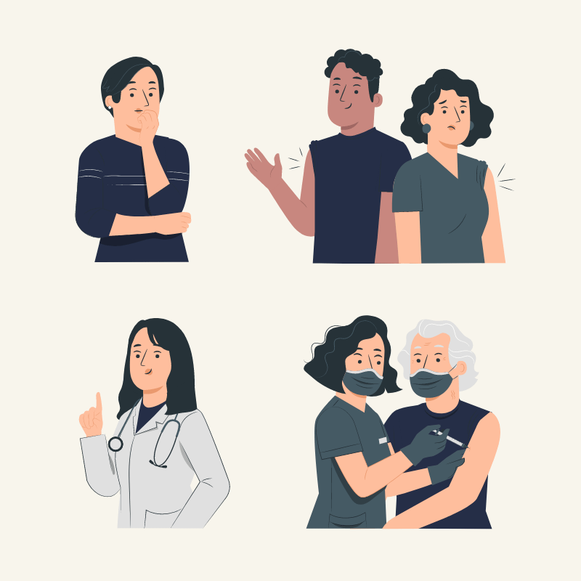
We are working hard to provide the best healthcare methods in Jordan to provide comfort to all patients
Thanks

